Slide 1
OpenAI vs azure openai
Notes:
I'm sure by now you've heard of the famous and exciting ChatGPT which is a product of OpenAI, a leading research laboratory focused on developing safe and beneficial AI. They've produced some of the most advanced AI models to date, including GPT-4, which can understand and generate human-like language. If you want to find out more about OpenAI and it models such as GPT-4,Dall-E, Whisper, ChatGPT and more, then the following are links to OpenAI’s models:

Slide 2
Who am I

Slide 3

What is openai
A leading research laboratory focused on developing safe and beneficial AI
They've produced some of the most advanced AI models to date, including GPT-4, which can understand and generate human-like language
OpenAI's research focuses on a wide variety of AI applications, from natural language processing to speech and beyond. Their work is aimed at solving some of the most pressing challenges in AI development, while also ensuring that these technologies are developed in a way that's safe and beneficial for everyone
Notes:
Anna

Slide 4
What have they produced
ChatGPT, a large language model trained by OpenAI.
GPT-4, OpenAI’s most advanced system, producing safer and more useful responses.
GPT-3.5, the current state-of-the-art language model from OpenAI that models that can understand as well as generate natural language or code
Whisper, an automatic speech recognition system from OpenAI that can transcribe and translate multiple languages.
DALL·E, OpenAI's image generation model. CLIP, an AI model that can understand images and text together.
MuseNet, an AI model that can generate music in various styles and genres.
Jukebox, an AI model that can generate music with lyrics and singing.

Slide 5
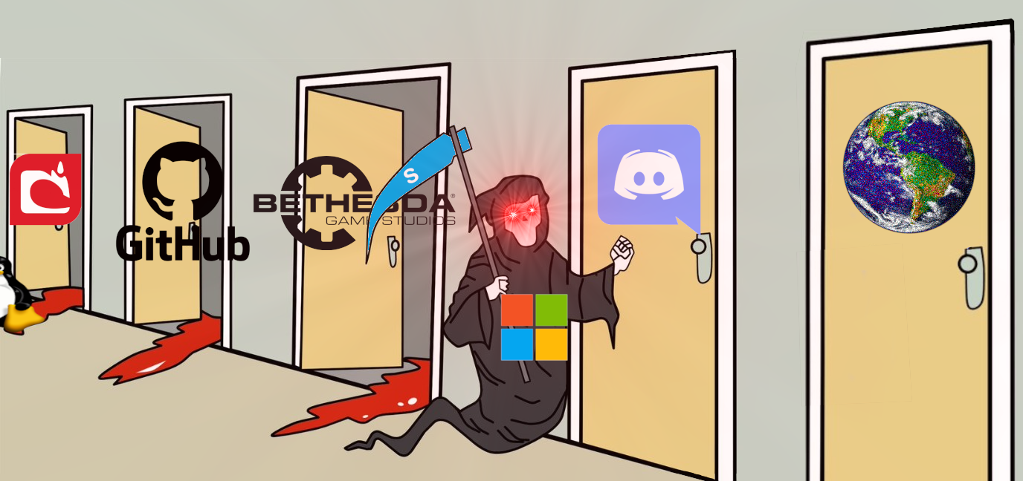
Microsoft likes to buy cool stuff

Slide 6
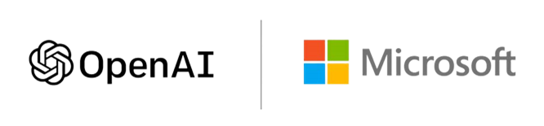
What is azure openai
Azure OpenAI is a partnership between Microsoft and OpenAI
By joining forces, Microsoft brings its powerful cloud computing resources to the table, while OpenAI brings its impressive knowledge and skills in AI. With this partnership, they're tackling some seriously tough challenges and creating some seriously smart solutions.

Slide 7
Openai vs azure openai
FEATURE
AZURE OPENAI
OPENAI
Ownership
Co-developed by Microsoft and OpenAI
OpenAI
GPT-4-Support
Supports the latest GPT-4 Models
This is a paid service with a month $20 subscription to ChatGBT Plus
Security
Offers the security capabilities of Microsoft Azure
Not Supported
Image Input Support for GPT-4
Not Supported Yet
Designed to be MultiModel,
but not specified
VNet and Private Endpoint Support
Supports VNets and Private Endpoints
Not Specified
Access
Need Access to Azure and requires an application to run OpenAI
Access Available to everyone

Slide 8
Openai vs azure openai
FEATURE
AZURE OPENAI
OPENAI
Learning Resources
Offers introduction to Azure OpenAI training course
Learning Resources Available
Support
Part of Azure Cognitive Services Support Options
Customer Support through various channels, including email support
Fine Tunes Model Creation
Allows the creation of up to 100 fine tined models
Not Specified
Training data for fine-tune modeling
Training data provided is only used to fine-tune the customers model and is not used to train or improve any model
Data provided to the API prior to March 1st 2023 may have been used for improvements
Prompts and completions for ChatGPT
Stored prompts and completions data for a maximum of 30 days in the same region, which is encrypted and only accessible to authorized Microsoft employees
Stores prompts and completions to train, or improve the models. Therefore, with this in mind, you should be careful when using sensitive data

Slide 9
Openai vs azure openai
FEATURE
AZURE OPENAI
OPENAI
SLAs for API Responses
The overall SLA for the Azure OpenAPI Service is the same as for other Azure Cognitive Services
Not Available but working towards it. They have a status page
Price for ChatGPT
(gpt-3.5-turbo)
Pricing is based on the pay-as-you-go consumption of $0.002 per 1k tokens (1000 tokens is around 750 words)
Free plan with some limitations with some paid plans, the price is $0.002 per 1k tokens
Regional
Availability
Currently only available in West Europe, East US and South-Central US
Provides API access to many countries, regions and territories

Slide 10
overview
Overall, Azure OpenAI is a service that offers advanced language AI with OpenAI models while providing the security and enterprise promise of Azure.
It is co-developed by Microsoft and OpenAI, ensuring compatibility and a smooth transition between the two.

Slide 11
Among their ground-breaking AI models, OpenAI's GPT-3 and GPT-4 models generates human-like language that's difficult to distinguish from language generated by humans. This model has enormous implications for natural language processing, chatbots, and other AI-driven applications. Meanwhile, their DALL-E model is capable of generating highly detailed, realistic images from textual descriptions, opening up exciting possibilities for creative industries such as advertising and design. Additionally, Codex assists developers in writing code more efficiently, potentially revolutionizing the software development process. It's clear that OpenAI is making significant contributions to the world of AI and technology, and the possibilities for the future are endless.

Slide 12
overview
Azure OpenAI also supports VNETs and private endpoints and allows for new use cases to be added through a limited access process.
On the other hand, OpenAI is a research organization focused on advancing artificial intelligence in a safe and beneficial manner.
While OpenAI does not offer the security and enterprise promise of Azure, it does provide comprehensive data privacy policies and learning resources.

Slide 13
summary
So whether you're an AI researcher, developer, or enthusiast, OpenAI is definitely an organization to keep an eye on. With their cutting-edge research and commitment to responsible AI development, they're helping to shape the future of technology in exciting and meaningful ways.
For those beginning their exploration of cutting-edge OpenAI models, OpenAI is an excellent starting point. However, for enterprise implementation, Azure OpenAI is the more suitable choice.

Slide 14
Useful links
Check out the Introduction to Azure OpenAI training course
See the support options for Azure Cognitive Services
See the OpenAI FAQs for confirmation of how data is stored
Check out the Cognitive Services section of the Service Level Agreements (SLA) for Online Services page
For the latest state of OpenAI’s operational systems, see the OpenAI Status page
Explore the regional availability for Azure OpenAI Service
See supported countries and territories for OpenAI models

